Slide 1
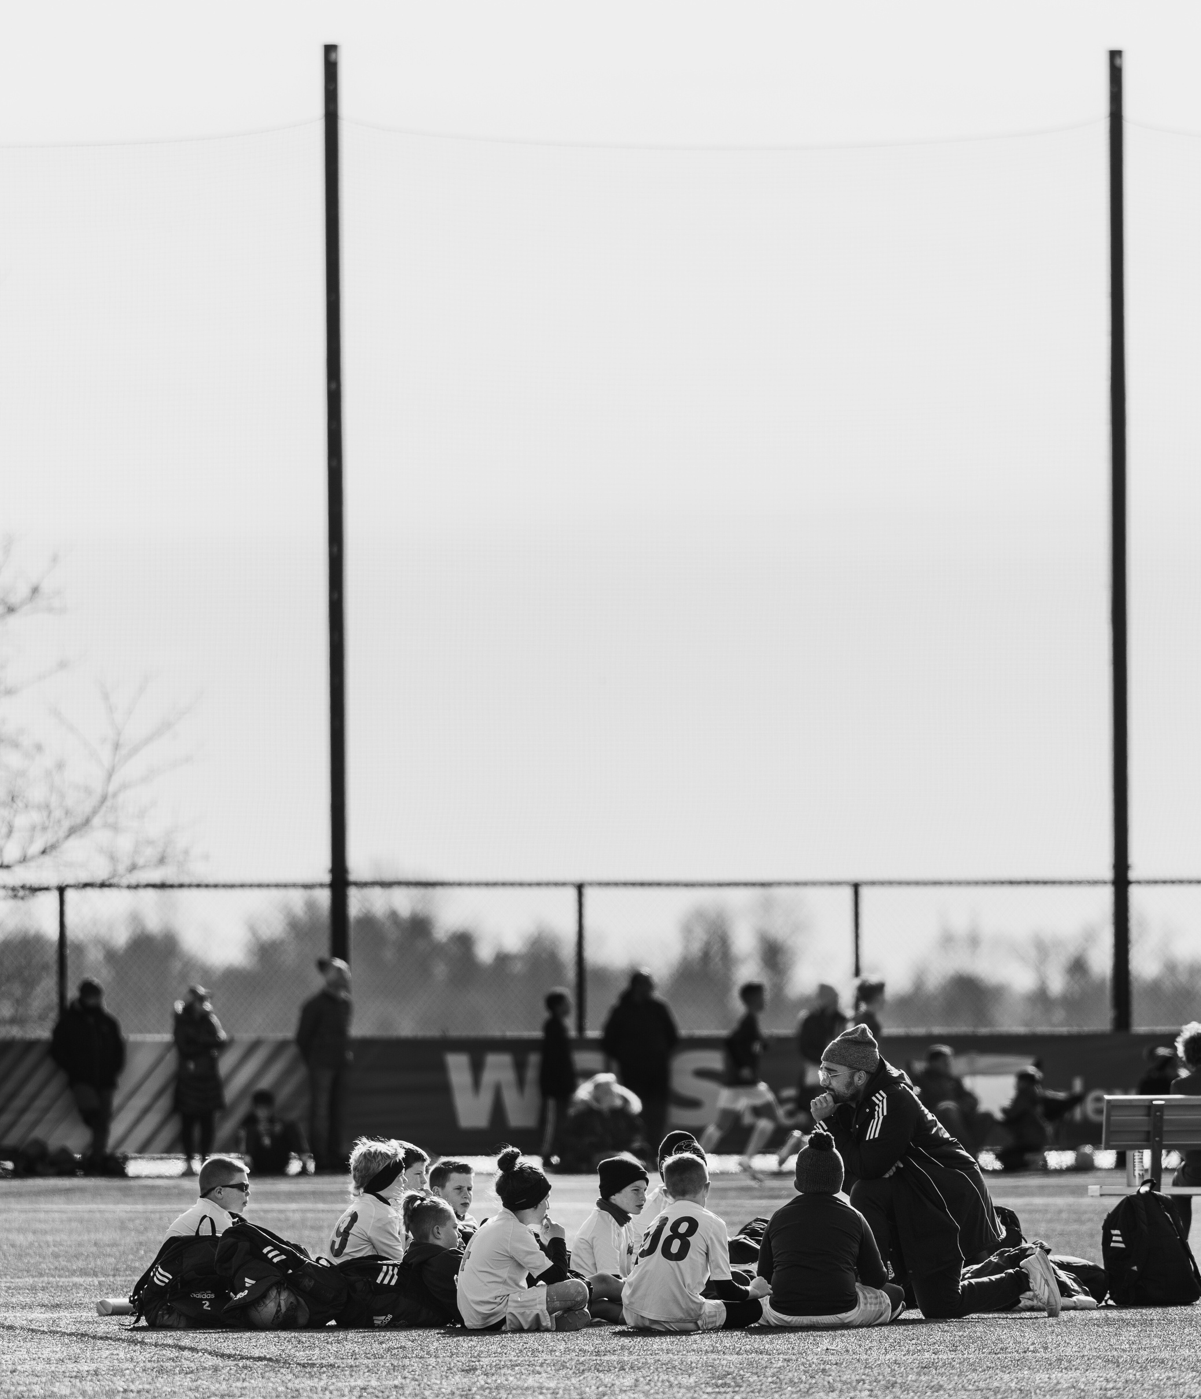

Magellan Performance LLC
COACH’S CORNER
Developing Technical & Mentally Confident Athletes
Magellan Mentality
The Art of Performance
Intro & Week 1

Slide 2
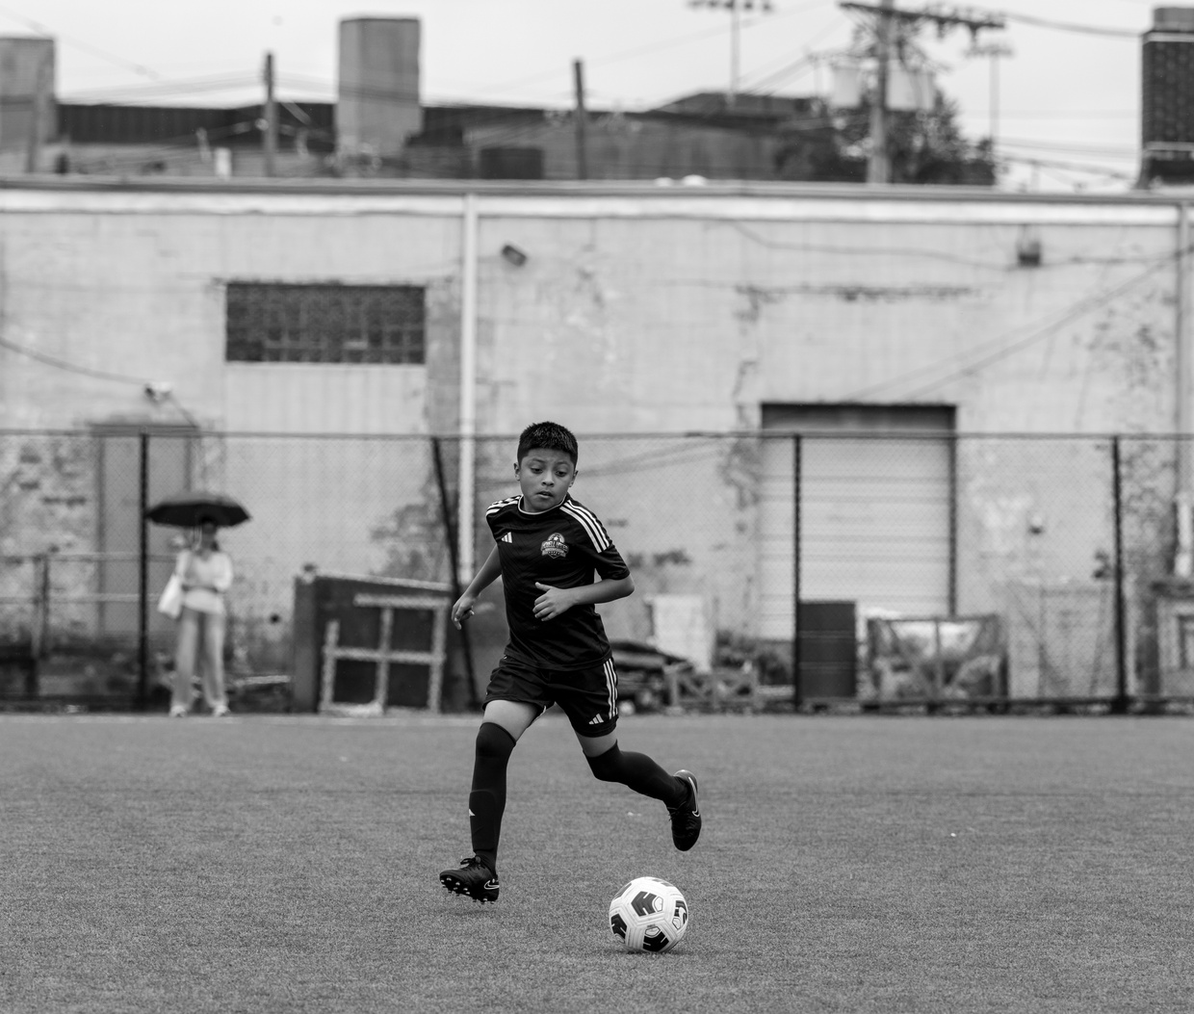
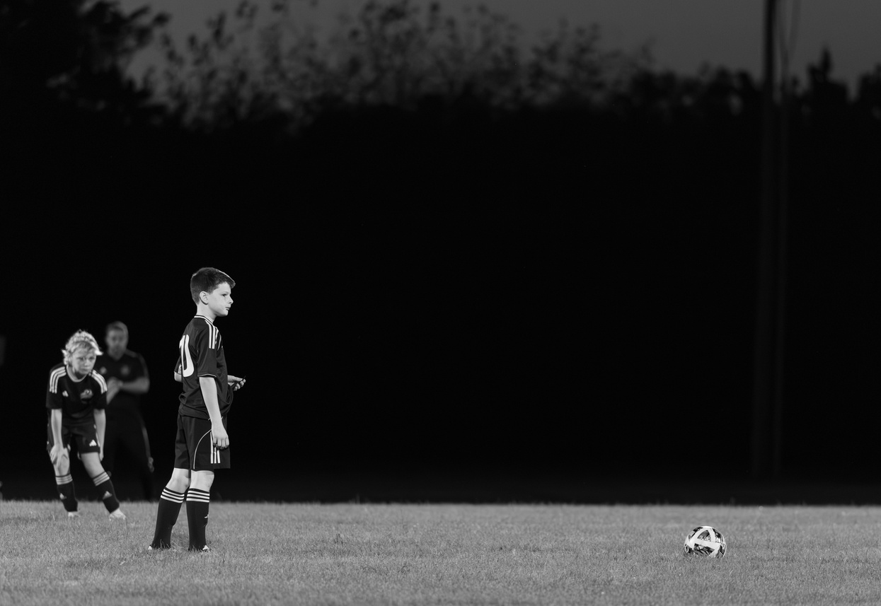

Why This Program Exists
Magellan Performance LLC
Youth sports is too focused on:
• Results
• Rankings
• Trophies
We focus on:
• Development
• Confidence
• Long-term growth
DEVELOPMENT
000

Slide 3
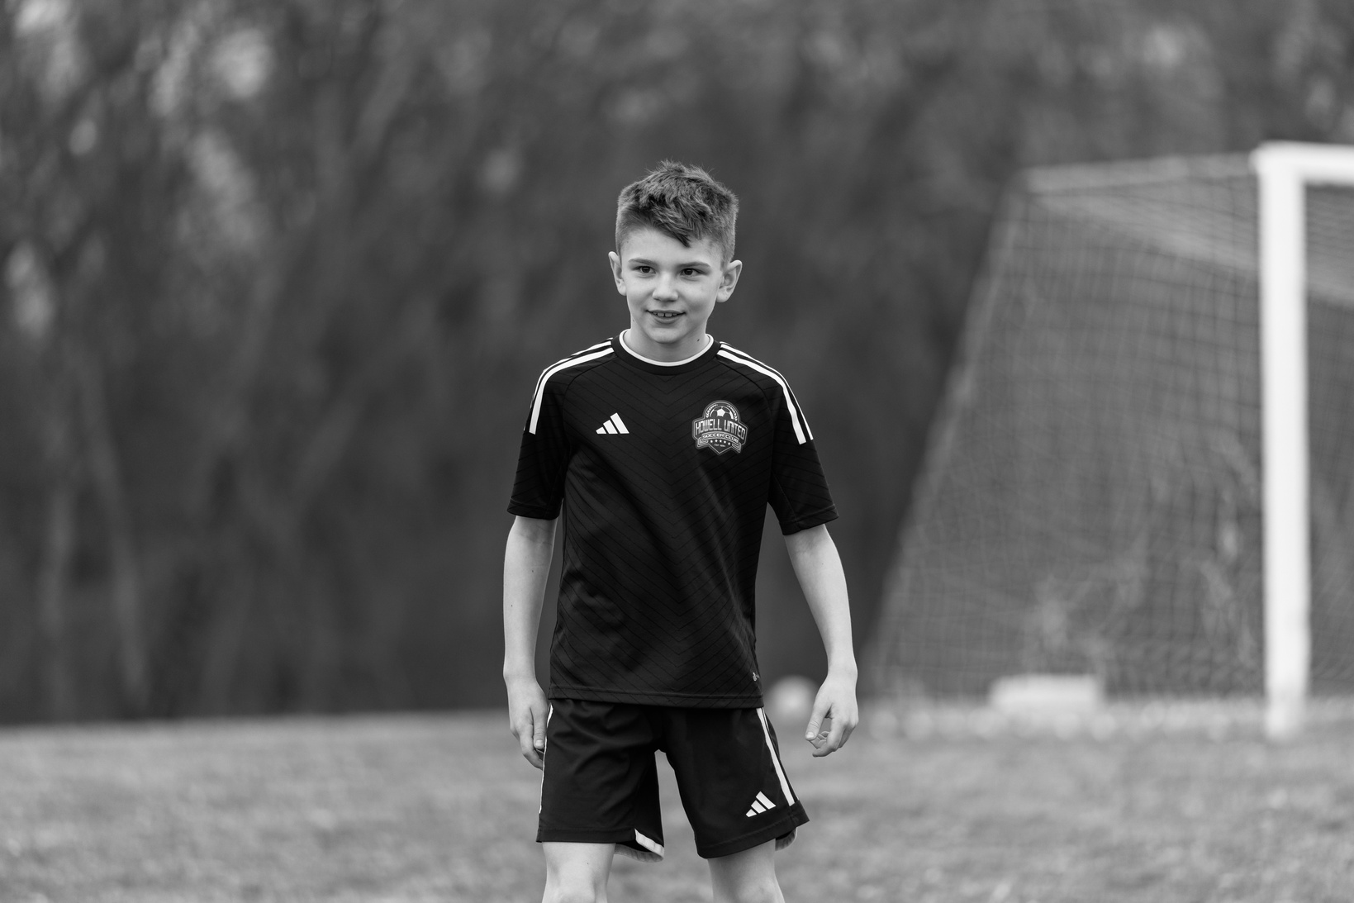
Magellan Performance LLC
THE MAGELLAN FRAMEWORK
Mental
Technical
Culture
Not just training.
Development that lasts.
Age Specific Development
Under 8: Love the game
U9 - U12: Build habits
U13 - U15: Build IQ
U16 – U18: Refine execution
000

Slide 4

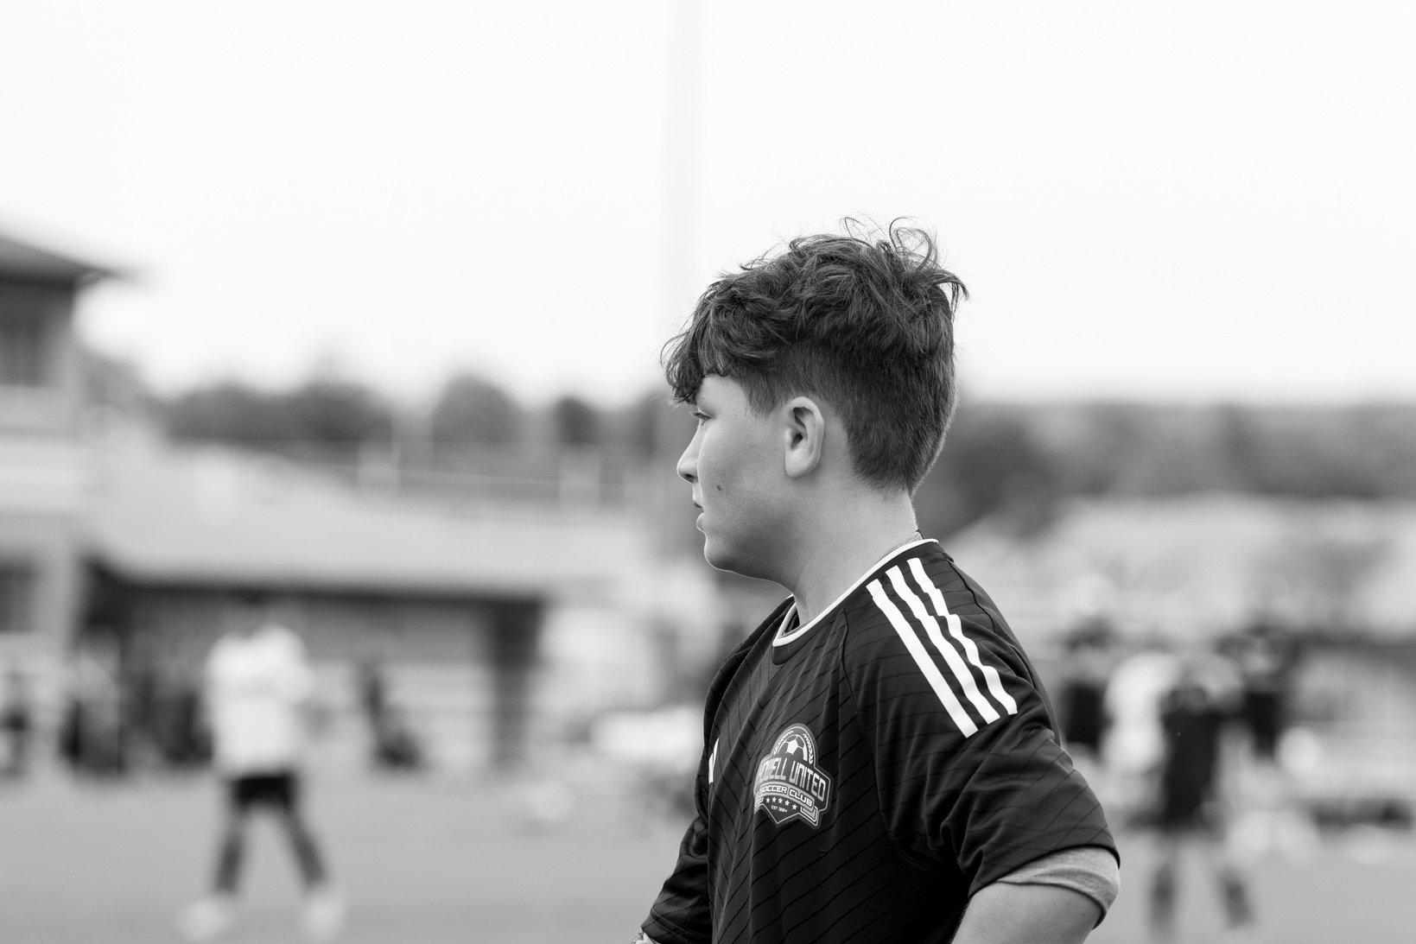
Magellan Performance LLC
THE MAGELLAN IDENTITY
RESULTS = OUTCOME BASED
Not about turning the club into an academy
Strengthen the Club’s identity across ALL teams
Red Bank Pride = RBFC
001
Notes:
This is not about turning the club into an academy.
This is about strengthening identity across ALL teams, lowest league to highest.
Tie into RBFC community, Red & Black pride, unity.
If results = outcome based then development will be lost. Need to reiterate the importance of growth through each player as individuals and as the team as a whole. How does each player/team look from game 1 to game 10? needs to be improvement. how do you get there?

Slide 5
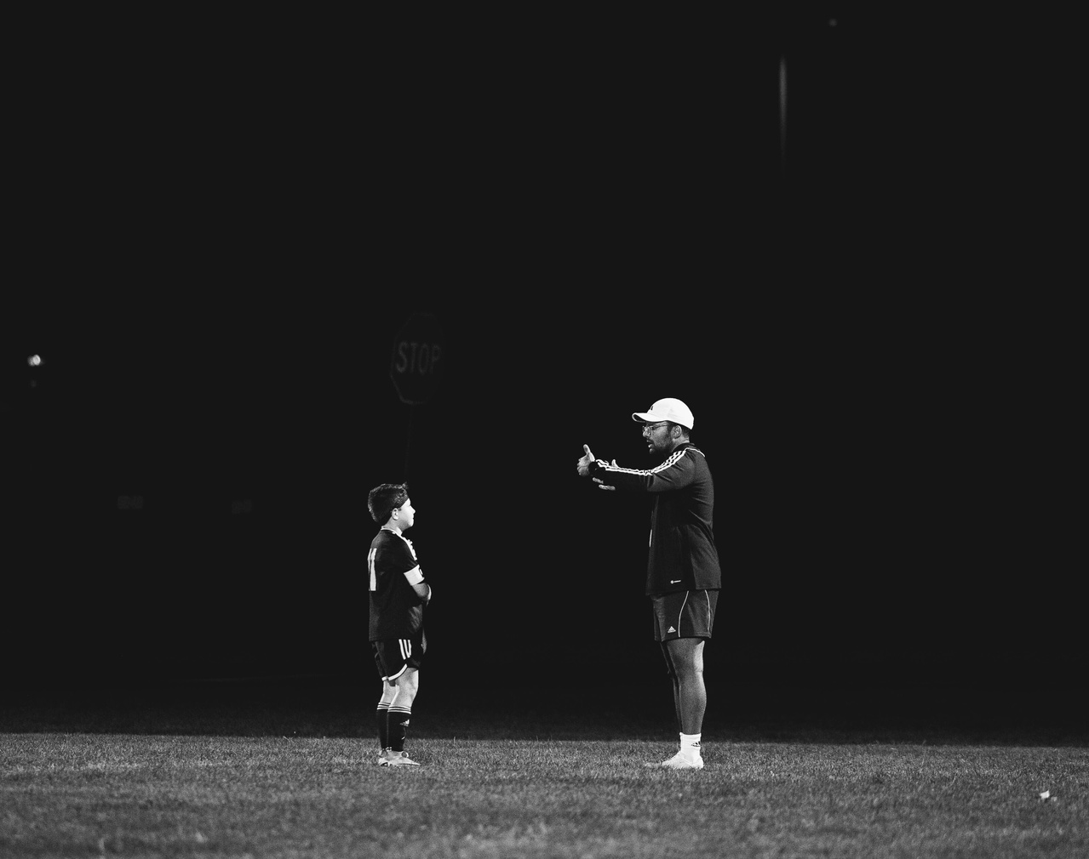
Magellan Performance LLC
Why Identity Matters
Culture shapes behavior.
Behavior shapes performance.
Performance shapes development.
Development grows to results.
STANDARDS
002
Notes:
Results are downstream. Goes nowhere for us.
Identity drives daily standards.
Ask:
What does Red Bank FC stand for?
What do parents say about our teams?
What do players feel when they wear Red & Black?

Slide 6
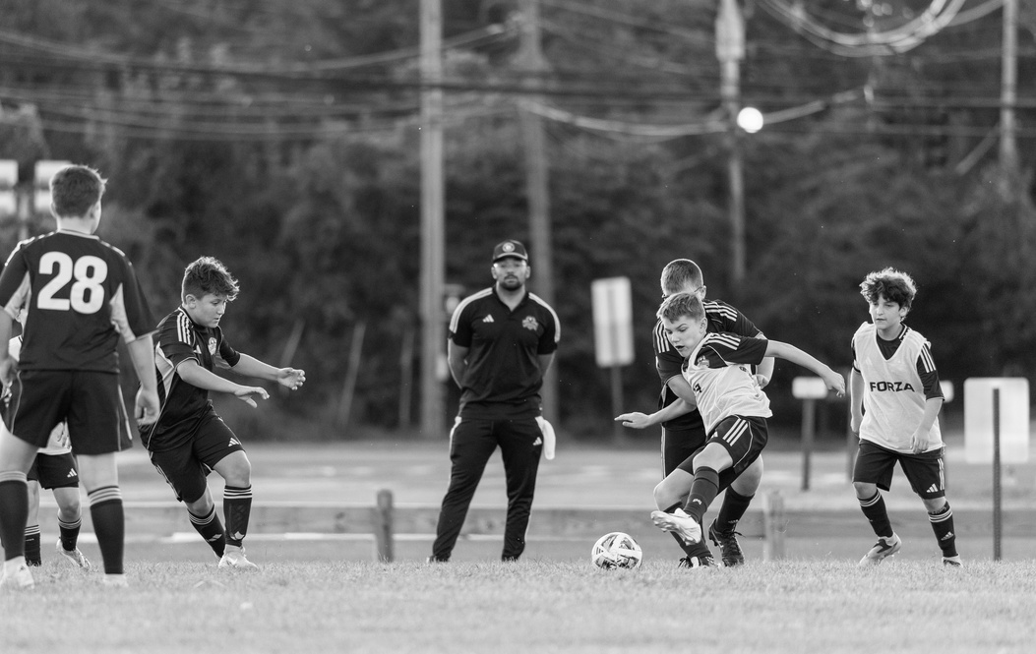

Magellan Performance LLC
DEVELOPMENT > RESULTS
“We don’t chase trophies.
We build players”
Results are temporary.
Development is permanent.
If your team wins but doesn’t improve, is that success?
003
Notes:
Ask:
Discussion (5 mins)
If your team wins but doesn’t improve, is that success?
Guide towards:
We tolerate mistakes to build growth.
Short-term losses for long-term competence.
Winning is an outcome, development is the system.
“We don’t chase trophies. We build players.”

Slide 7
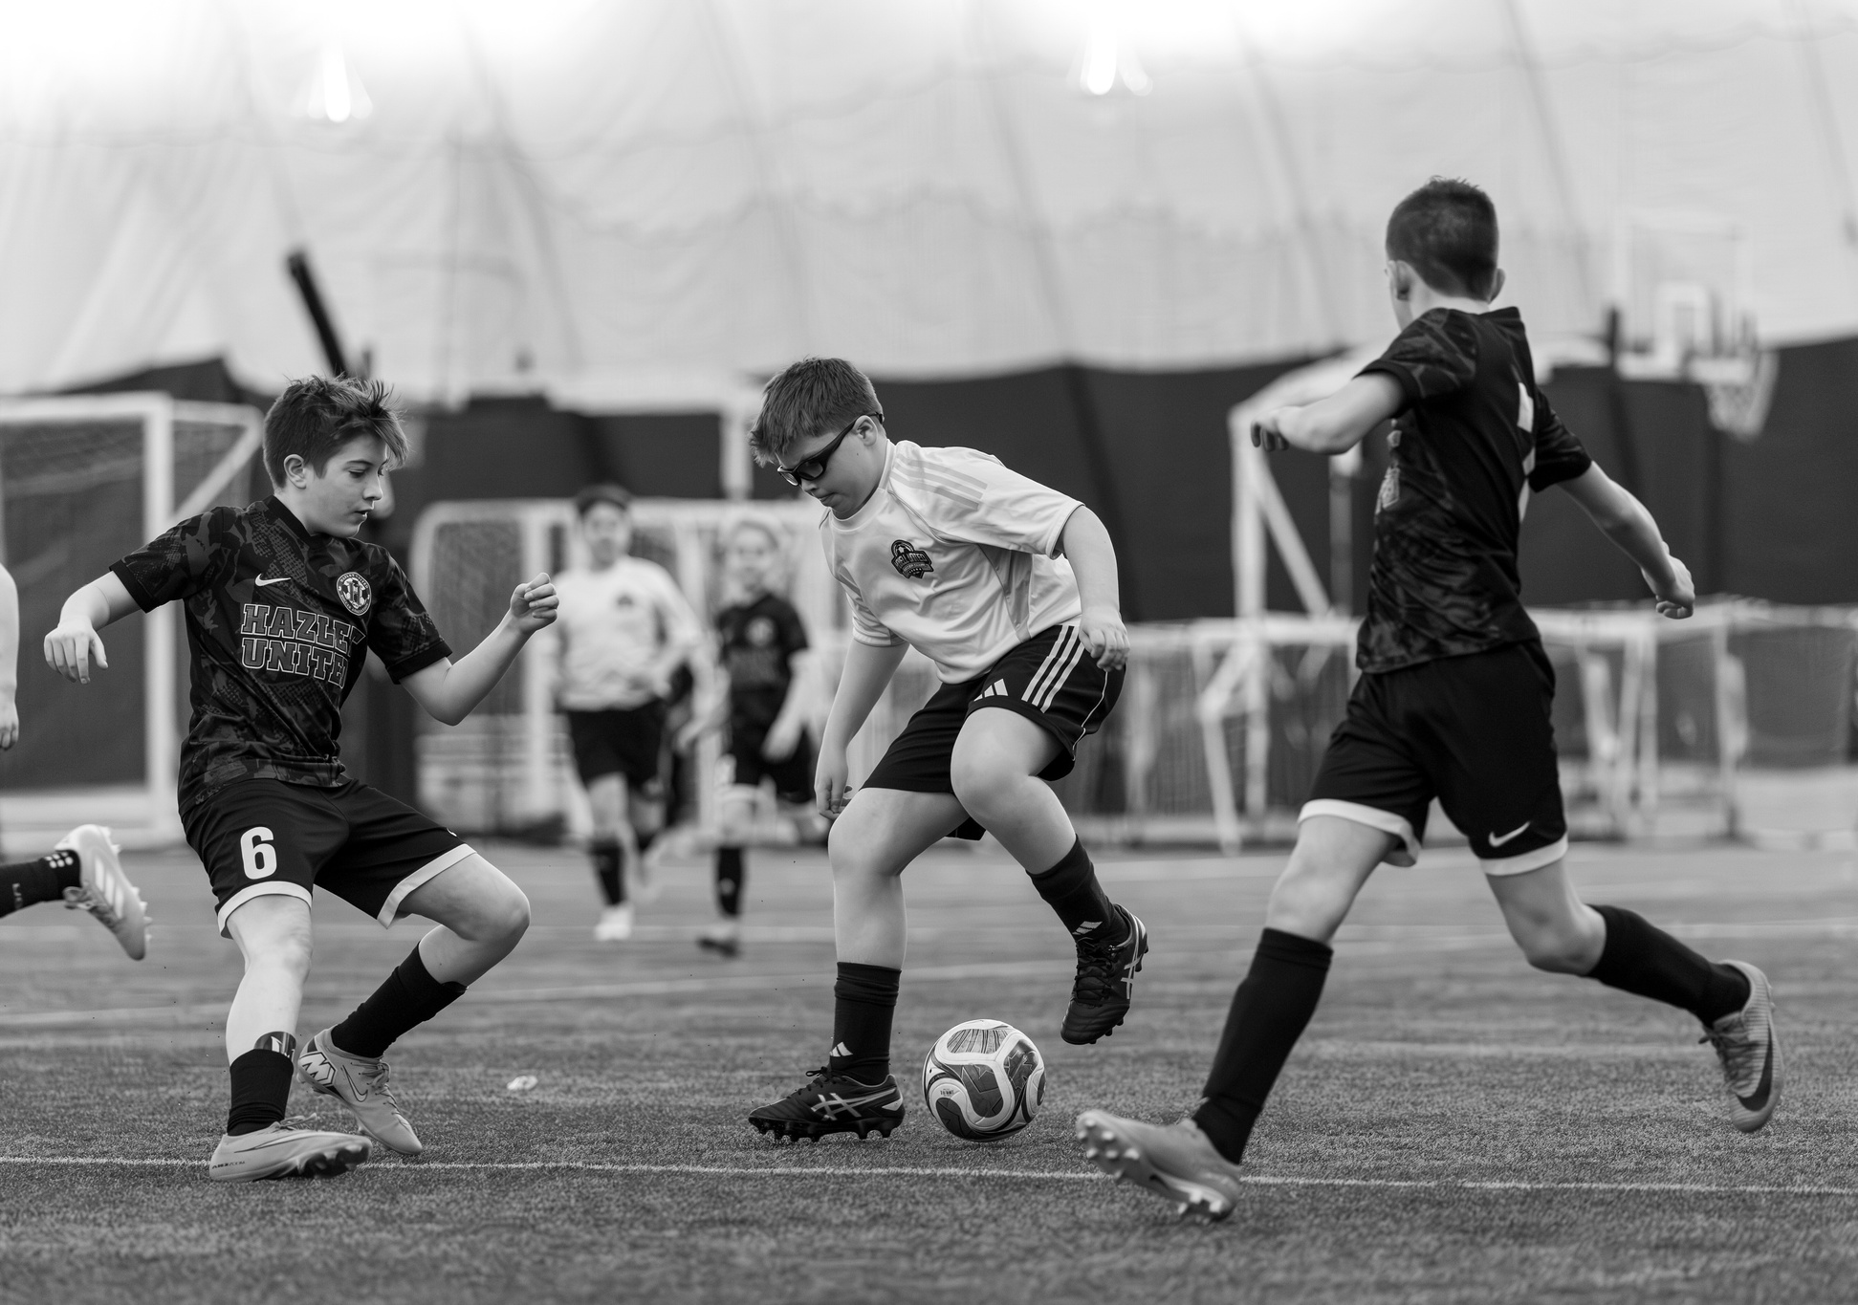
Magellan Performance LLC
THE TRAP
Early structure ≠ long-term mastery
Over Coaching
Over Structuring
Fear Based Play
Players Scared to try
Winning is great until its not
Early Success from structure without skill will collapse later
004
Notes:
Over-coaching.
Over-structuring.
Fear-based play.
Players scared to try.
Ask:
Have you ever seen a “great U10 team” disappear by U14?

Slide 8
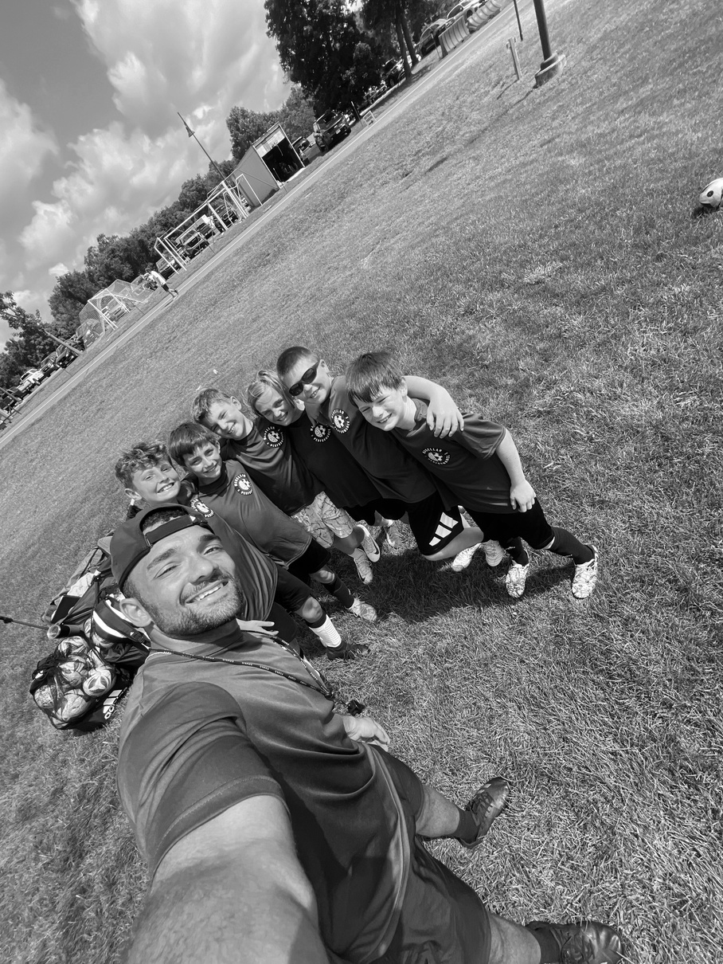
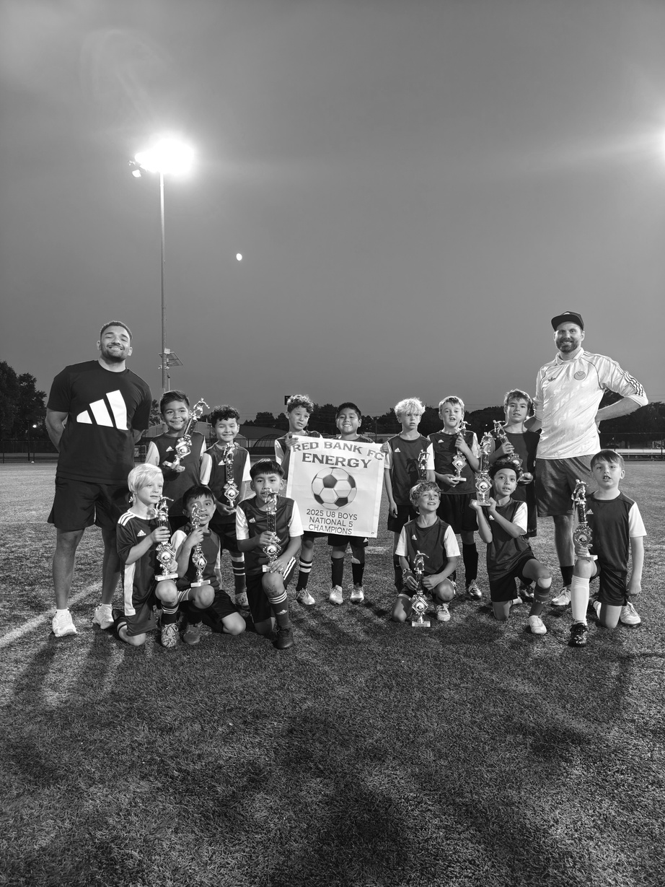
Magellan Performance LLC
COACHING STANDARD
We Develop:
Technical quality
Decision making
Mental resilience
Team character
Technical = repetition with detail
Tactical = age appropriate
Mental = emotional control
Character = team culture mindset
005
Notes:
Connect to your Magellan Performance philosophy:
Train with Purpose.
Play with Confidence.
Grow with Resilience.
Explain:
Technical = repetition with detail.
Tactical = age-appropriate.
Mental = emotional control.
Character = team-first mindset.

Slide 9

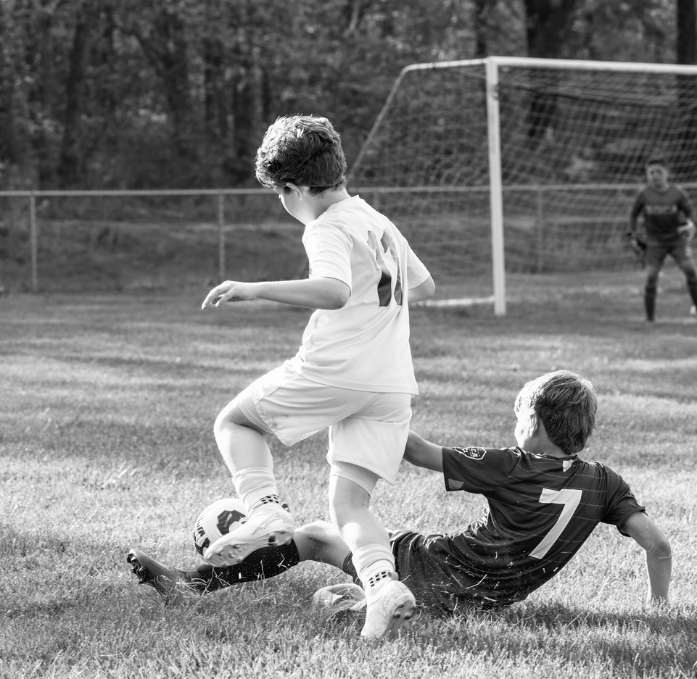
Magellan Performance LLC
AGE SPECIFIC
DEVELOPMENT
6–8: Love the game
9–12: Build habits
13–15: Build IQ
16–18: Refine execution
09
Freedom shapes Performance for the future.
Notes:
No reason why 6-8 year olds should be worried about pressing triggers or passing combinations, get them comfortable with the ball at their feet and competing for FUN!
9-12, we can now explore different skills with the ball and how to emphasize the importance of making good connection with it as well as body mechanics
13-15, as things become much mor competitive and serious, we are not understanding the concepts of why we do different things on the pitch and what it can lead us to.
16-18, every detail matters now knowing different positions, spaces, and how different skill sets such as vision and IQ can make a massive difference when physicality and skill are all even.

Slide 10
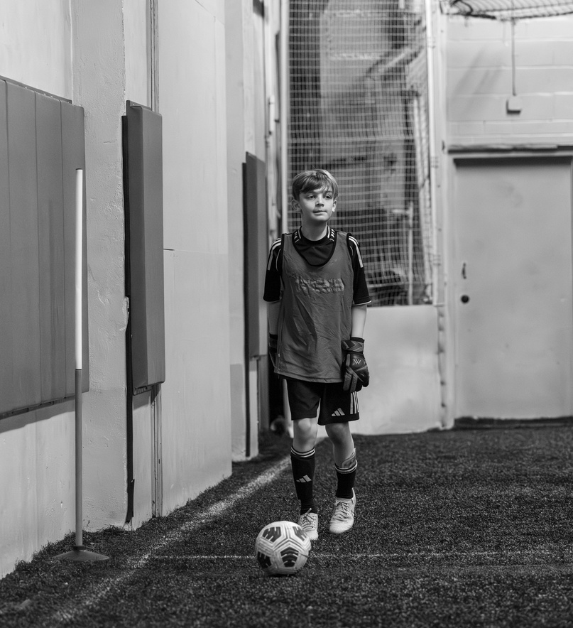
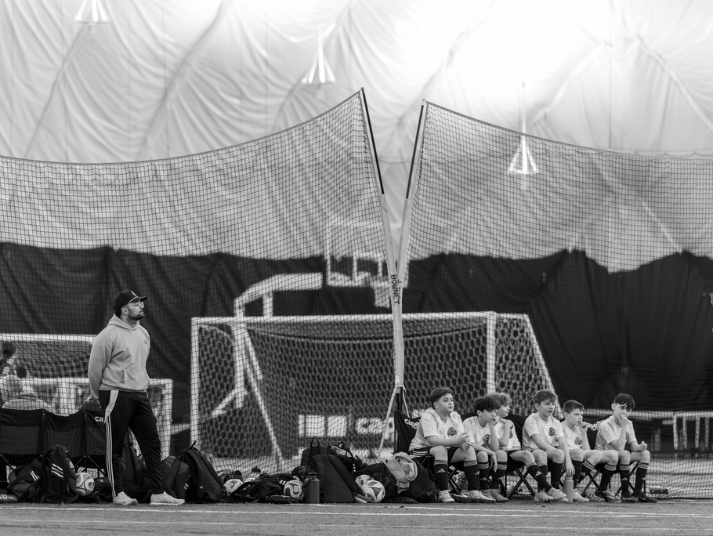
Magellan Performance LLC
AGES UNDER 8
“fun is development at this age.”
Focus:
Ball touches
Fun competition
Confidence
Exploration
Do NOT focus on:
Shape
Pressing Triggers
Complex Build out patterns.
007
Notes:
If they quit at 8, nothing else matters.
No lectures.
1 ball per player.
Celebrate creativity.
Key Line:
“Fun is development at this age.”

Slide 11

Magellan Performance LLC
AGES 9-12
Build Habits
Focus:
First Touch
Ball Mastery
1v1 Confidence
Work Rate Habits
Introduce:
Simple principles of play
Basic positional awareness
008
Notes:
This is the GOLDEN technical age.
If they leave this stage:
Without a first touch
Without comfort on the ball
We failed.
Avoid:
Over-systemizing.

Slide 12
Magellan Performance LLC
13 - 15 YRS OLD
BUILD IQ
Focus:
Decision speed
Scanning
Game understanding
Transitional moments
Introduce:
Pressing triggers
Positional rotations
Tactical nuance
Are you coaching solutions?
Are you asking questions?
009
Notes:
They can now process WHY.
Ask coaches:
Are you coaching solutions?
Or are you asking questions?

Slide 13
Magellan Performance LLC
16 - 18 Yrs Old
Refine Execution
Focus:
Tempo mastery
Accountability
Role clarity
Mental Toughness
REFINE
Now:
Mistakes are corrected
Standards rise
Effort is non negotiable
010
Notes:
6-year-olds don’t need pressing triggers.
17-year-olds need accountability and tempo mastery.
That contrast matters.

Slide 14
Magellan Performance LLC
MISTAKES ARE INFORMATION
Mistakes = Data
Not Identity
When a defender makes an error, what do you say first?
Correct behavior, not personality
011
Notes:
Do we punish mistakes?
Or coach through them?

Slide 15
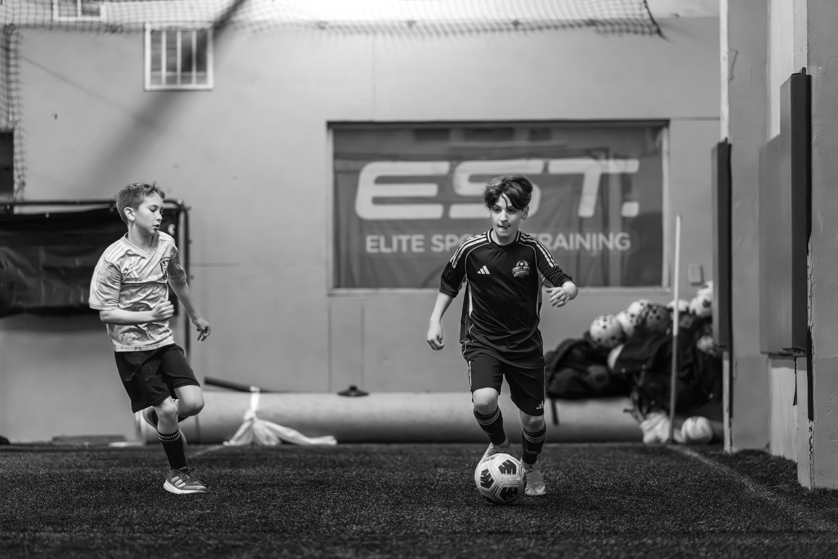
Magellan Performance LLC
TECHNICAL WORK
is non - negotiable
Repetition builds confidence
Confidence builds freedom
Needs to have a portion of your sessions focus on the athletes’ relationship with the ball
Detail over Volume
012
Notes:
Every session needs ball mastery, even 17 year olds
Technical sharpness declines without repetition

Slide 16
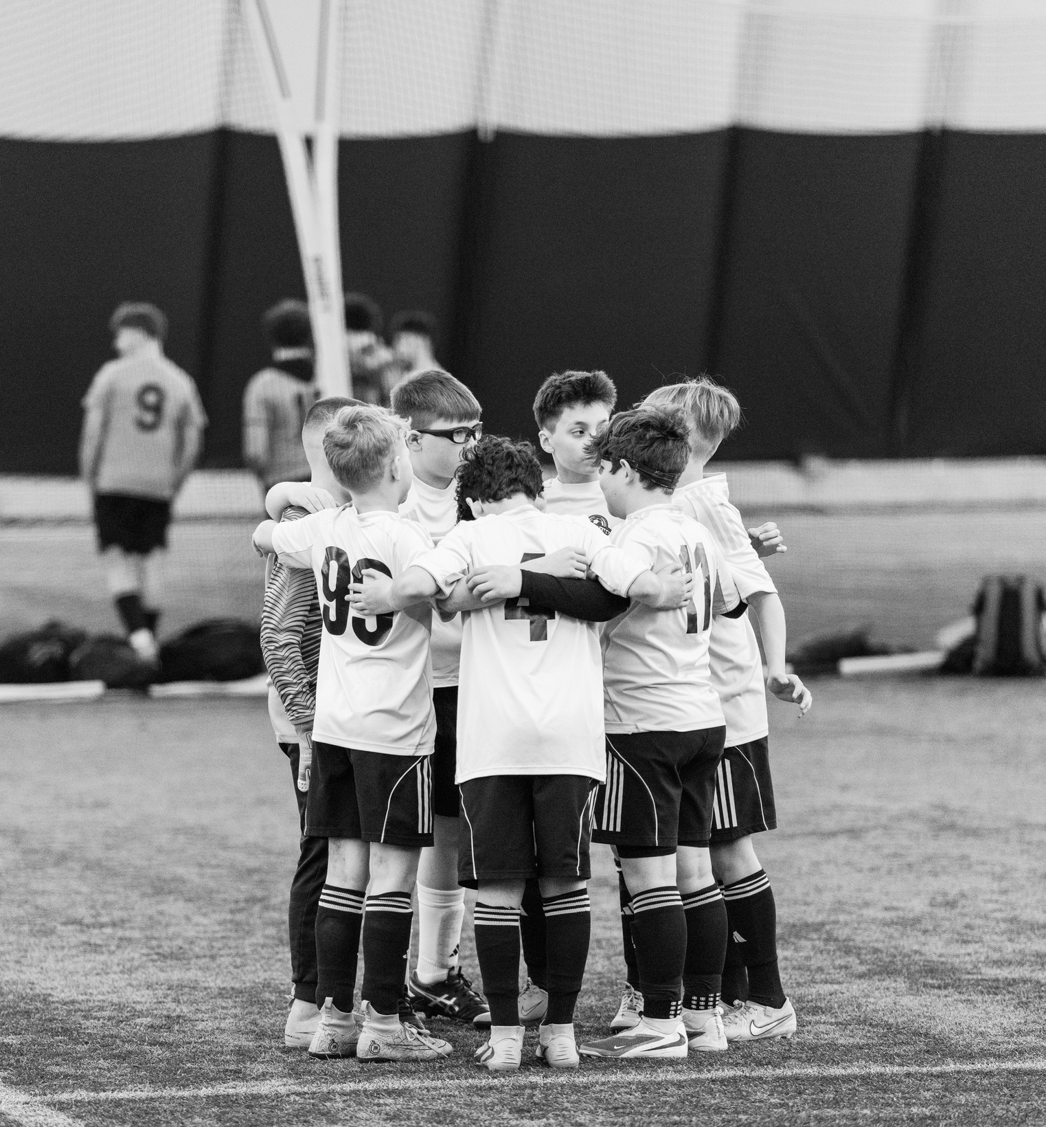
Magellan Performance LLC
Team Identity
RBFC = One
We are ONE Club
Red & Black.
Family.
Work Ethic.
Unity.
FAMILY
Needs to be a connection between U8 to U18
013
Notes:
We are not building an academy hierarchy.
We are building club pride.
From lowest league to highest.
How can U8 and U18 feel connected?

Slide 17
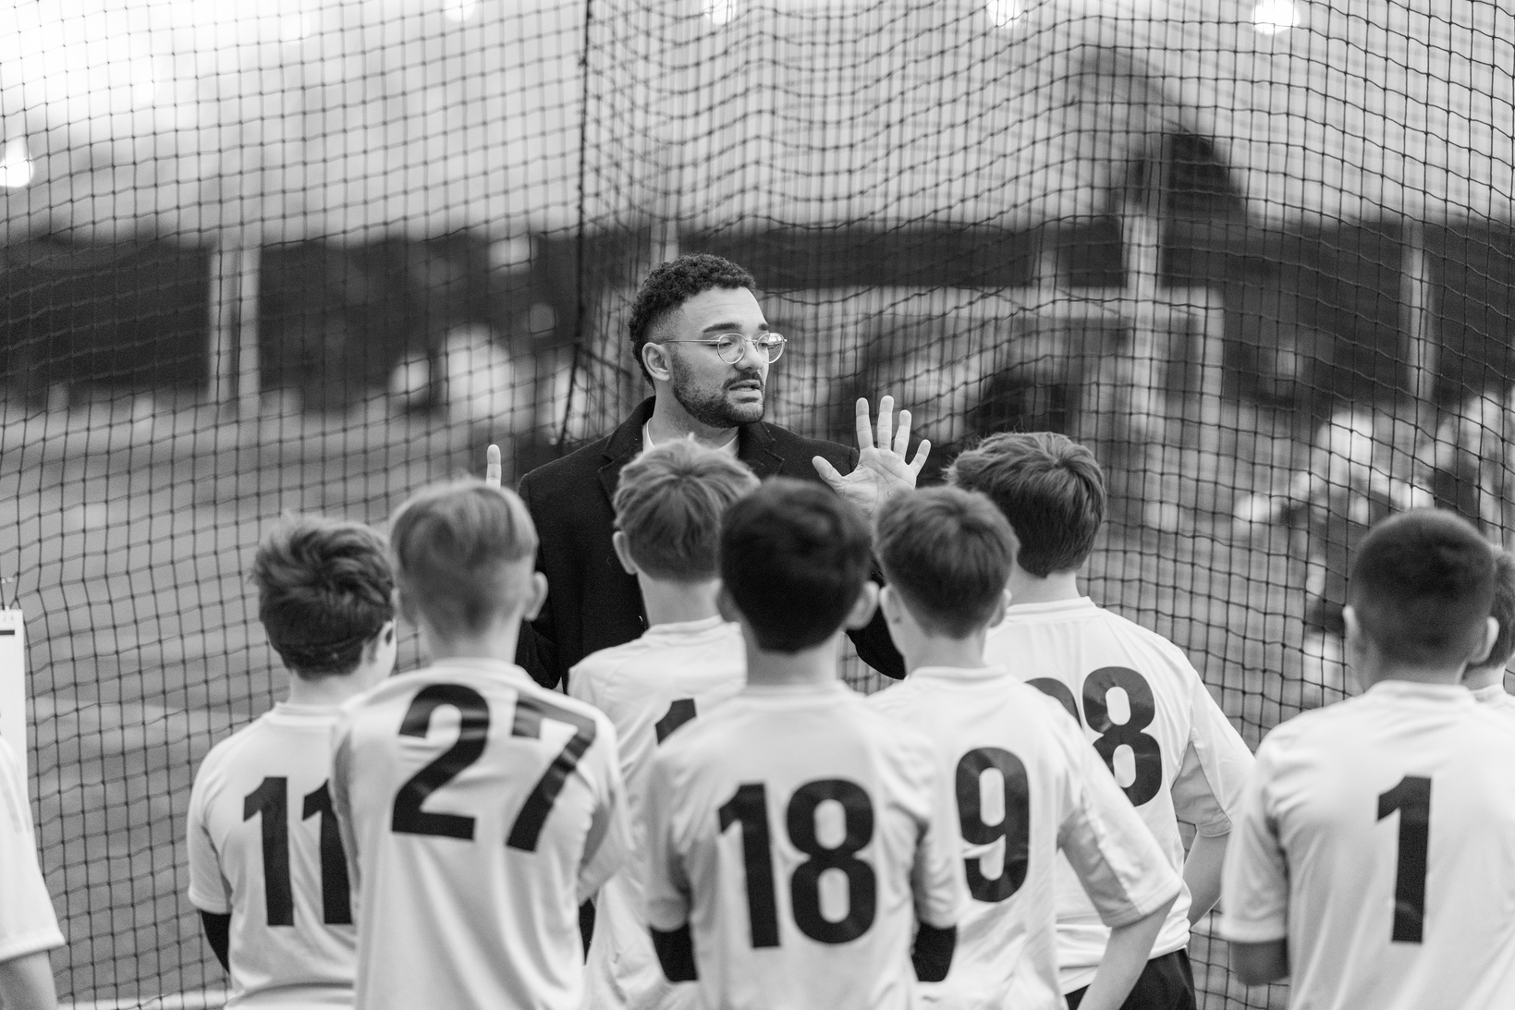
Magellan Performance LLC
SESSION FILTER
Coaches Check in with your sessions:
  Is this age appropriate?
  Is this building skill?
  Is this building character?
  Is this building confidence?
Flexibility is essential
014
Notes:
Do we punish mistakes?
Or coach through them?

Slide 18
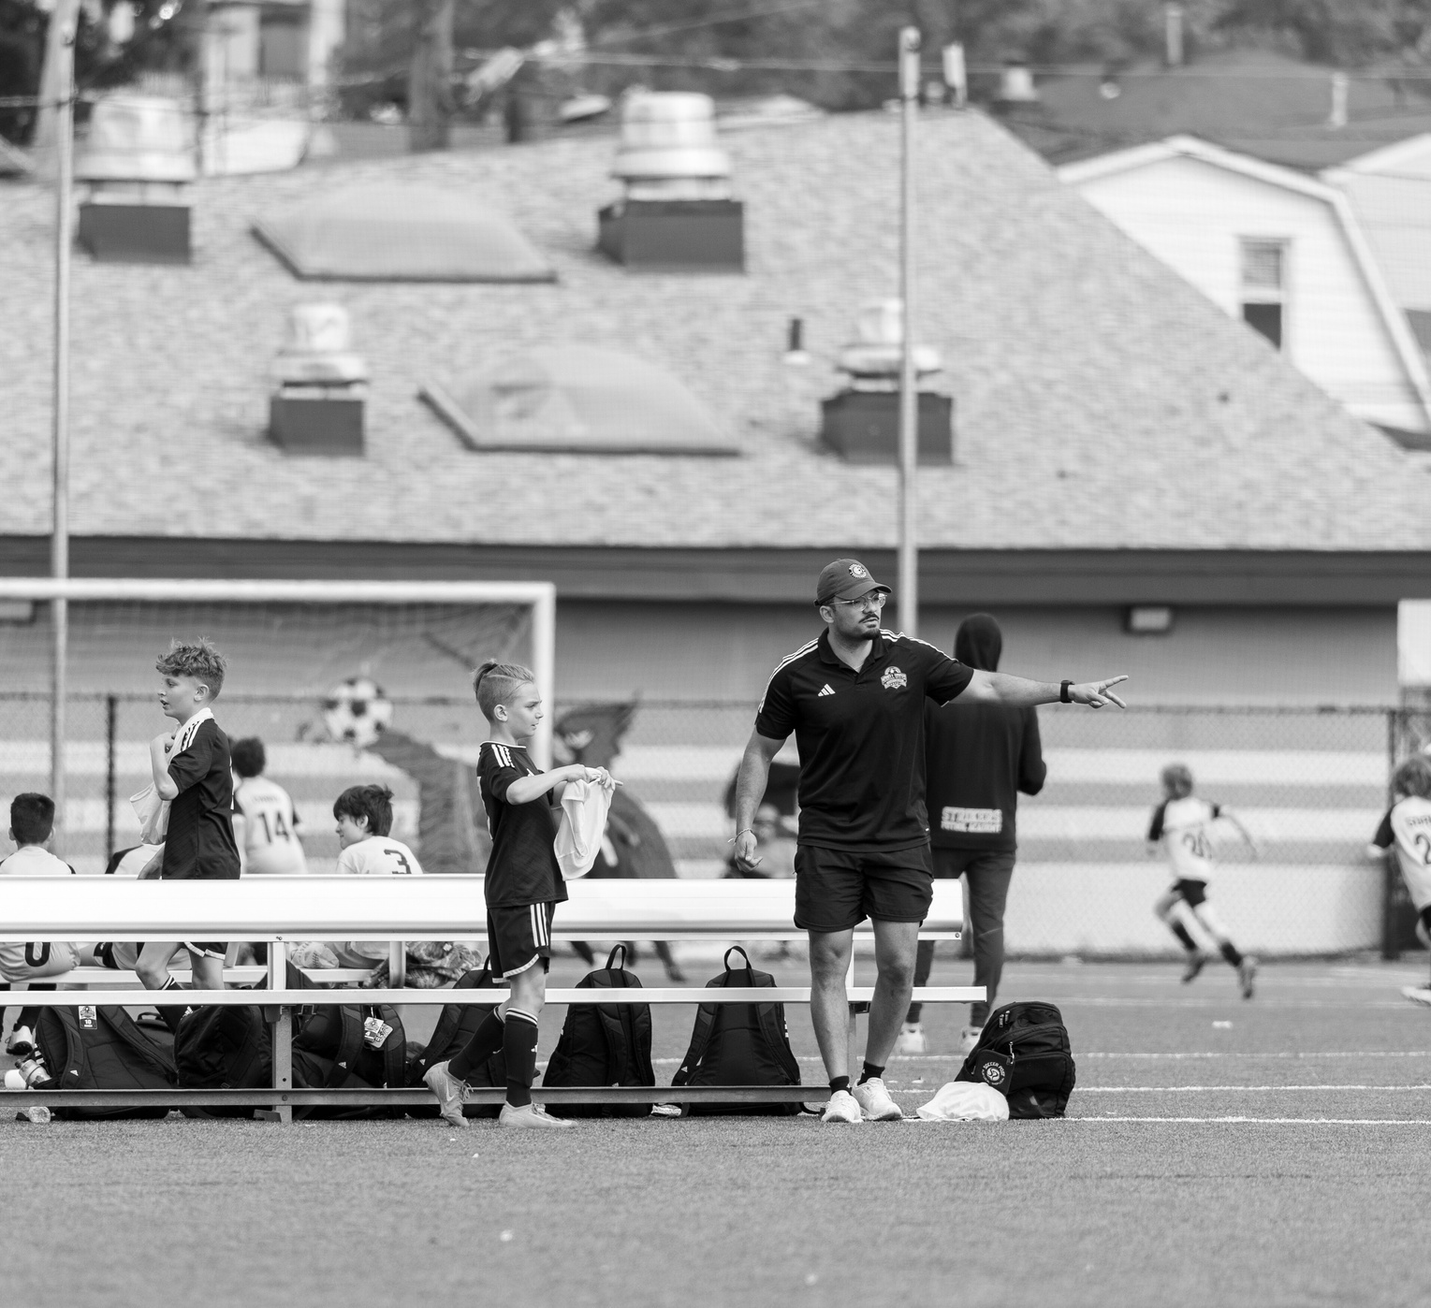
Magellan Performance LLC
REFLECTION
Write Down:
  One thing you over emphasize
  One thing you under emphasize
  One change you will make this season
015
Notes:
Share in the group to brain storm

Slide 19
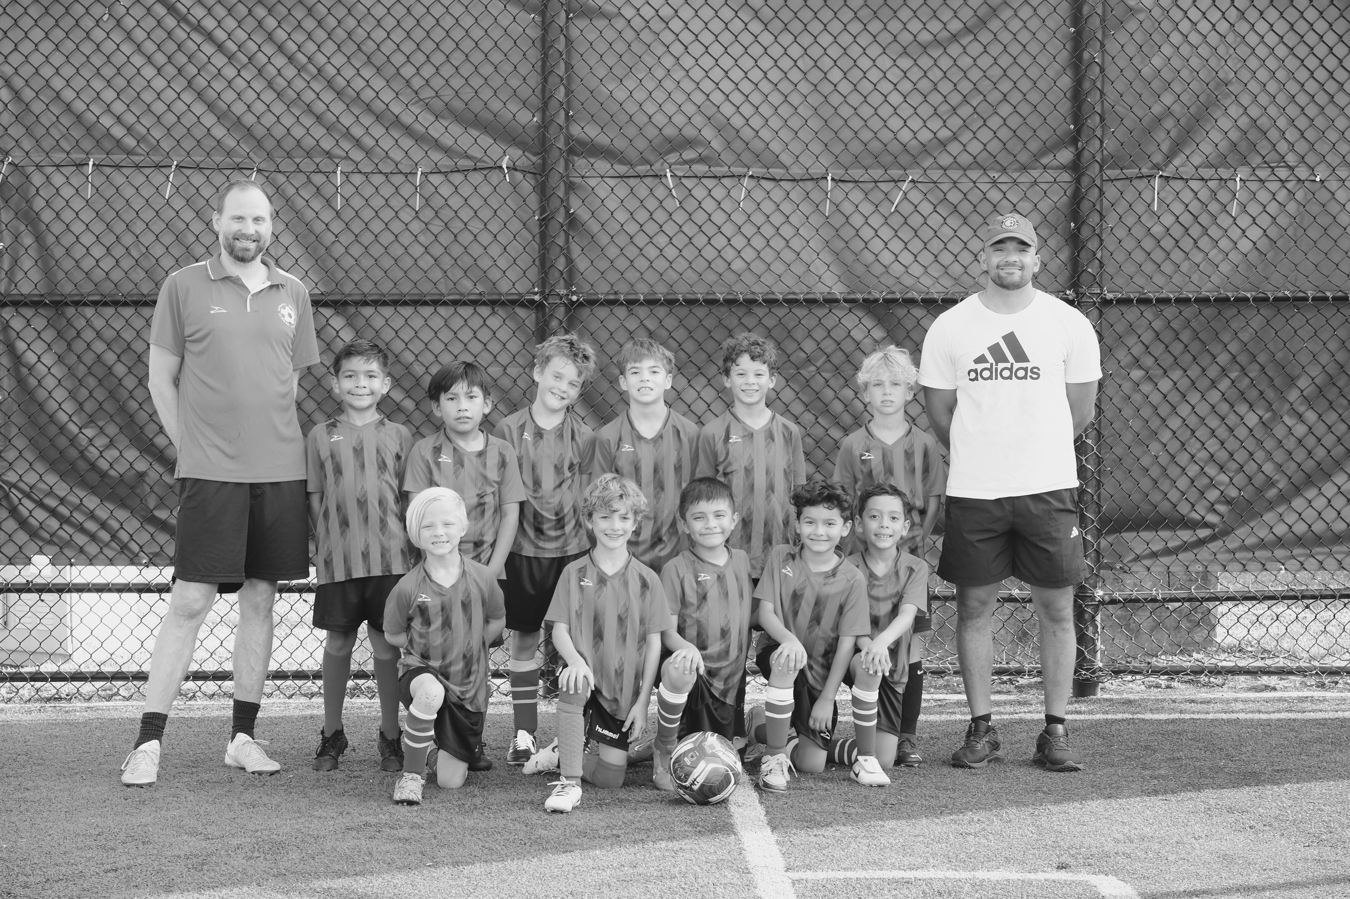
Magellan Performance LLC
REMEMBER
We build players.
We build people.
Results will follow.
016
Notes:
Development is slower and it requires patience, but it lasts.
No one cares about the undefeated season or that championship they had at 10 years old, they remember what they learned from those experiences and how it anchored them to work on certain things or told themselves that they didnt need to any more, until it was too late.

